Slide 1
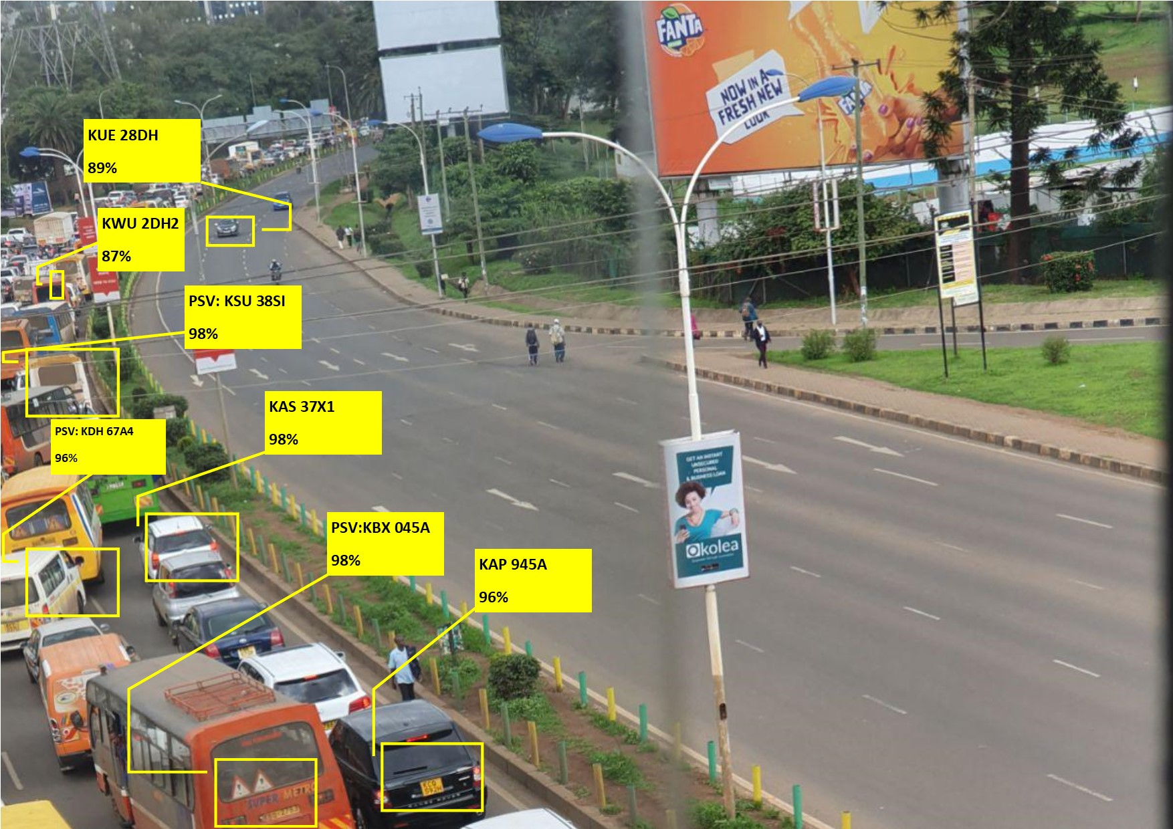
IMPROVING ACCESSIBILITY AND EFFICIENCY OF PSV(public transport) INSURANCE.
By combating moral hazards in PSV (public transport) insurance using surveillance systems.
Author: Stanley Sayianka

Slide 2
IMPROVING ACCESSIBILITY AND EFFICIENCY OF PSV(public transport) INSURANCE.
- By combating moral hazards in PSV (public transport) insurance using surveillance systems.
Author: Stanley Sayianka

Slide 3
Problem Definition Based on research, studies and analyses that I read focusing on PSV insurance in Kenya and the challenges it faces, the major conclusions I obtained are outlined below: 1. Weak enforcement of traffic laws – Due to this, there exists incessant violation of these rules by PSV drivers and conductors. This usually leads to enormous cases of road accidents which has a ripple effect of increasing liabilities to insurance firms 2. Fraudulent claims.(fraud aided by lawyers, claimants and medical personnel), This leads to reduced profits by insurance firms 3. The lack of integrated data system on PSV insurance. – Lowers the confidence of such insurance firms to accept such risks. Due to the challenges faced by insurance companies in insuring PSV risks, it leads to many insurance companies avoiding PSV risks and thus the insurance market on PSVs
Notes:
Moral hazards-human characteristics which lead to exaggerated losses.

Slide 4
Solution In order to combat the mentioned challenges and thus improve the willingness of insurance companies to accept PSV risks, an insurance company can adopt a system of surveillance on roads, especially on roads and streets where the PSV(matatus) operate, or on high claim-frequency spots. These surveillance systems(using CCTVs), will ensure real time monitoring of PSVs, stepping up in the place of weak enforcement of traffic laws as well as enabling insurance companies to have evidence in proving/disproving liabilities and challenging validity of claims. The data obtained from the surveillance cameras can also be used in monitoring behavior of PSVs or drivers, such as over speeding, careless driving and over-taking, and over-loading passengers

Slide 5
In this surveillance system, it will be expensive to actually hire individuals to monitor the videos of cars on streets and high ways, but an alternative exists, we could employ pattern recognition models(Deep learning algorithms) to aid in extracting information from the massive data obtained from video footages. Due to the advances in computing power, and the increase in processing power of computers(using GPUs), these models can sieve through massive amounts of data from the surveillance cameras in considerable time. The data obtained from the networks of surveillance cameras, can be uploaded in real time, or sequentially in batches to cloud infrastructure, where the model will sieve through the data in order to extract meaningful information. Information we desire to get from the data includes: 1. The car number plate to act as the primary key in the central database. 2. Information regarding the state of the car i.e over-speeding, over-loading, or dangerously driven.

Slide 6
Steps used by the Model The following steps could be used by the models 1. The footages are fed(uploaded) on a sequential basis to the model, or real time depending on choice of interest. 2. The model scans the frames in the footage and identifies objects of interest(cars). 3. From the objects identified from a particular frame of the footage, the model tries to employ text recognition algorithms to obtain the number plate of the cars and then uses the number plate to lookup whether it is an insured PSV and if yes, it creates a record for the car in a centralized database in the cloud or on a block chain facility. 4. The model then judges(based on calculated logic, and metrics) whether, the particular object(car) was over-speeding, over-loaded, or being dangerously driven(over-lapping). This will be explained in detail below. 5. The central database is then updated each time the car number plate is observed from the footage. 6. For accidents, then it would need intervention of individuals, to watch the footages and identify whether the car(of interest) was on the wrong, (such a task is hard for models)

Slide 7
Feasibility of the system(Surveillance cameras): An insurance company willing to employ this system, will not require to install its own surveillance cameras, since on major highways(where PSVs operate), the government transport authority has already installed high quality surveillance cameras on major roads. Along major roads where big buildings are situated e.g. banks, they also could be having surveillance cameras which could be facing major roads of interest, and this could be of great help to the insurance company. The insurance company could liaise/get some permission from the buildings with CCTV cameras of interest or the National Transport Authority.(in charge of surveillance cameras in major high ways) They do not necessarily need to get copies of video footages, e.g. if the NTSA uploads the video footages to a certain cloud storage such as Google cloud, we would only need to be granted permission to access the videos(with “read-only” permission, and that would be enough).

Slide 8
Feasibility of the system(The model/algorithms): The models that would be involved in the work of extracting information from data footages and updating our records based on the data are freely available such as: 1. OpenCV – an open source computer vision library 2. Tensorflow – Google’sopen source Machine learning framework 3. Tesseract – an open source text recognition engine 4. Azure and AWS – These are cloud infrastructure from Microsoft and Amazon respectively, they allow deployment of models to the cloud infrastructure and also allows companies/individuals to use their GPUs(processing units), and progress can be monitored real time. They are not free but have manageable monthly subscription fees. All these libraries/services are available in open source programming languages such as python and R, and come with ready made templates, to assist in model development. The model can then be deployed to the cloud, where it would go on with its work.

Slide 9
In order for these Machine learning model to learn how to extract the information we desire from the data from footages, it needs to be “trained”, using similar data. Similar data here implies :video footages of PSVs, location of interest(number plates) from the PSV footages, we also need to show/train our model with sample video footages showing over-loaded PSVs, over-speeding PSVs, and dangerously driven PSVs, so that in the future, given previously unseen footages, our model can learn to categorize and spot PSVs that are over-loaded, over-speeding, and being dangerously driven. After the model is trained with data instances of interest, we can perform validation(a kind of pilot testing) under monitoring of individuals, so that if the model qualifies(is able to spot PSVs cars, spot and record their number-plates correctly, and correctly assess how they are being driven), it can now be “trusted” and deployed to the cloud, where the data also is uploaded.

Slide 10
Possible Costs. The possible costs that could be incurred by an insurance company willing to benefit from this system are as follows: 1. Possible government fees – For one to be authorized to use video footages, and extract information from surveillance cameras for personal use, there must be some government regulations set in place to be observed(Data protection Bill), such as registration with the relevant body, and approval needed to place surveillance cameras. 2. Surveillance systems - The cost of placing and maintaining its own surveillance cameras, or buying data from companies/banks already owning surveillance cameras in places of interest(Major highways).This could be a one time cost or monthly cost. Although the cost is low, since we don’t place the surveillance cameras allover the country, but in areas of interest only.(e.g. in major high ways, and city streets). 3. Model training - The cost of hiring experienced data labelers, who will work on training the model with relevant data footages and labelling the footages. This is also incurred only once since the model does not need to be trained more than once. 4. Cloud infrastructure – The subscription costs to get services from cloud technologies such as Microsoft Azure, or Amazon AWS services, in order to upload and train the model as well as storing data footages there. This cost is manageable, (due to the stiff competition among cloud infrastructure providers, it is easy to get affordable costs.)

Slide 11
Partnership The insurance willing to adopt this system could get partnership from bodies such as: 1. NTSA(National Transport and Safety Authority) 2. The traffic police authority 3. The Insurance Regulatory Authority of Kenya(IRA) 4. Other insurance companies willing to partner and be part of the system. 5. The government as well, since this system will also help in monitoring safety in roads, and safety of citizens.

Slide 12
Challenges solved 1. Weak enforcement of traffic laws – This system could possibly lead to a positive reactivity or Hawthorne effect among drivers, since when PSV drivers are made aware that there are surveillance cameras monitoring them, It could possibly create the effect of observing traffic laws, avoiding over-speeding and over-loading, and avoiding fraud during claiming process at all. This is because they will be made aware that every mistake they make on roads will affect their claim. 2. Fraudulent claims. – This system, will be able to track and record all cases of accidents that occurred in the spots where the surveillance cameras are placed, thus the insurance companies will have sufficient evidence in proving or disproving liability. This will make drivers, and PSV owners more honest regarding claiming, since frauds could affect their insurance policies and even future policies they will seek to undertake. 3. The lack of integrated data system on PSV insurance – Due to the adoption of this system, there will be a common central database that could be shared among the insurance sectors issuing PSV insurance. It will make the process of tracking the insured PSVs, monitoring their behavior, and premium loading easier. A centralized motor insurance data system would aid in the consideration of insurance firms to underwrite PSVs and this will revive the PSV insurance market.
Notes:
The Hawthorne effect occurs when people behave differently because they know they are being watched. Reactivity is a phenomenon that occurs when individuals alter their performance or behavior due to the awareness that they are being observed. The change may be positive or negative, and depends on the situation.

Slide 13
Inclusivity and aim When such data on PSVs becomes available to an insurance company or the insurance market in Kenya, then challenges associated with PSV insurance such as weak enforcement of traffic laws, fraudulent claims, challenges in claims and policy renewal and lack of an integrated data infrastructure on PSVs would be solved. Insurance companies would then be interested in the PSV market once again, and this would ensure active under-writing of PSV risks in Kenya. This would lead to an increase in the uptake of PSV business in the Kenyan market. This would further improve ease of access of PSV insurance to major PSV saccos and individual owners due to the booming PSV insurance market.

Slide 14
Case scenario 1: A car is observed driving in Lane 14A, The model identifies: 1. That the car is a PSV (for the sake of example number plate KCD 037D). 2. The car is over-loaded and driving on the wrong lane. 3. The car is over-speeding, based on the speed limit on this street and speed is approximately calculated by distance observable by the surveillance camera divided by the number of seconds elapsed when the car is in motion on the observable range of the camera. 4. The model captures all this data, and creates a new record e.g.: 5. In case of claim processing, we will first have to analyze records and view all entire records of this particular car, to assess its general behavior on road based on its appearances on our records, and thus pay claims accordingly or alter premiums accordingly.
Day | Month | Year | Car ID | Location | Time in | Time out | Approx speed | Overlap | Overload
21 | March | 2021 | KCD 037D | Lane 14A | 12:07:45 | 12:08:23 | 67 mps | YES | YES

Slide 15
Case scenario 2: An insured PSV, comes to process a claim and states that an accident just occurred last night or such as the car was stolen, and the police arrived late(or something which could be of an excuse). If the car happened to pass on a street with our surveillance system, then we will be able to do a simple search and see when the car passed e.g: The driver claims the accident occurred around 12:00, but on the records, there is no record which matches with that, then this could be termed as fraud on the side of the insured or: The driver was seen to over-speed, then a penalty will be charged since it could be that over-speeding was the cause of accident.

Slide 16
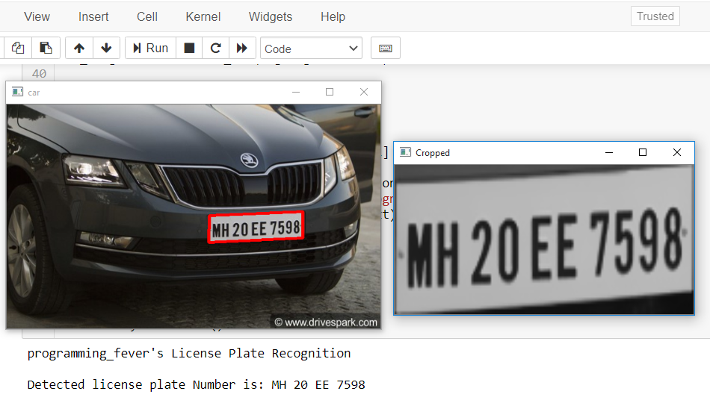
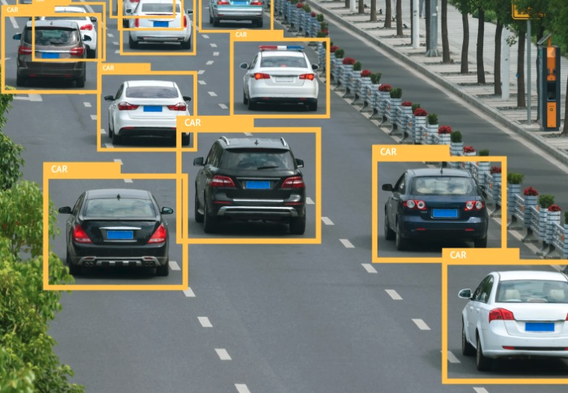
Labelling data for training the model
The free and open source openCV computer vision library that is used for text recognition in images and video footages

Slide 17
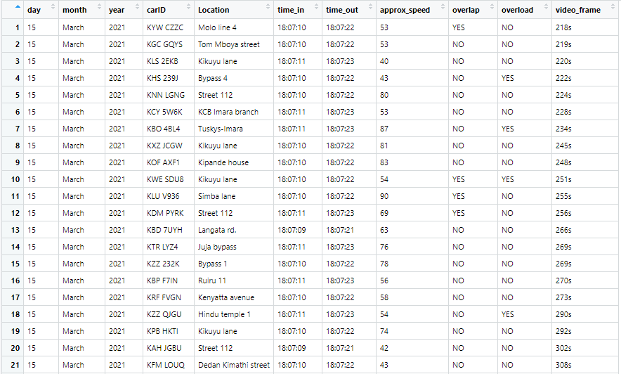
Sample data that could be fetched
Variables of interest:
1. Day
2.Month
3. Year
4. Car number plate
5. Location observed
6. Time first seen
7. Time last seen on footage
8. Approximate speed
9. Was the car overlapping or being driven in wrong lane
10. Was the car over-loaded
Particular video frame-for later evidence

Slide 18
Abbreviations NTSA – National Transport and Safety Authority IRA – Insurance Regulatory Authority PSV –Public service vehicle openCV – Open Computer Vision

Slide 19
References 1. Lotuiya, F. (2014). Challenges faced in PSV insurance sector in Kenya: how adequate is the legal and the enforcement mechanism? (Doctoral dissertation, University of Narobi). 2. Wekesa, J. N. (2010). Underwriting challenges facing public service vehicles insurance in Kenya (Doctoral dissertation, University of Nairobi, Kenya). 3. Kinyua, K. N. (2012). Factors affecting the performance of insurance companies in Kenya: a case of insurance companies offering cover to public service vehicles in Meru County (Doctoral dissertation, University of Nairobi, Kenya). 4. Odunga, H. B. (2015). Testing for the correlation between geographical area of operation and accident risk in PSV insurance industry.

